Slide 1





MENTORZONE
“Your Passport to Global Career Opportunities”
MSc Business Analytics
MIS41050 - TECHNOLOGY CONSULTING
GROUP 11
Bhargav Bachanahalli Shekarmurthy (23200186)
Rufus Meera Gomathi Sankar (23200015)
Shivang Ranjan (23200060)
Vignesh Yalagondahalli Sreenath (23200087)

Slide 2

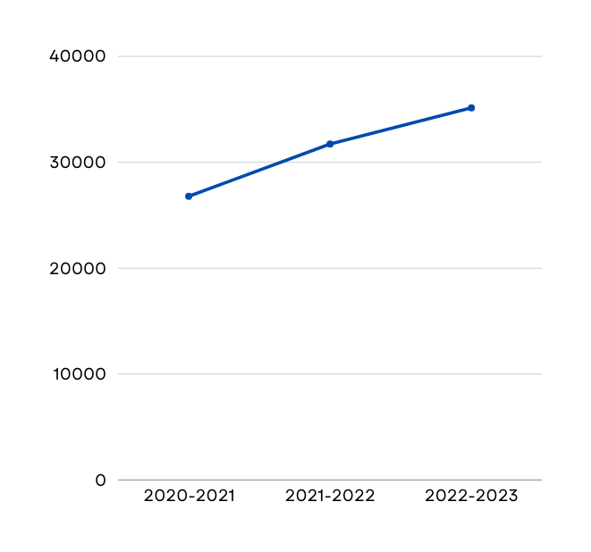

MARKET RESEARCH
5.5%
*
of YoY international enrollments in Higher Education
*
€1B
632.5M
35140
Annual income earned from international students
Projected Annual Income
by
31720
26785
2027
* Data for students travelling to Ireland for higher education.

Slide 3





VALUE PROPOSITION
MENTEE
One-stop solution for education & career planning
Access to current university students and alumni mentors
AI based personalised career planning
EDUCATION CONSULTANT
Cloud based Student Management System (CRM)
ML based Application Conversion Score
Increased student enquiries
MENTOR
Passive income generation
Opportunity to hone leadership skills

Slide 4
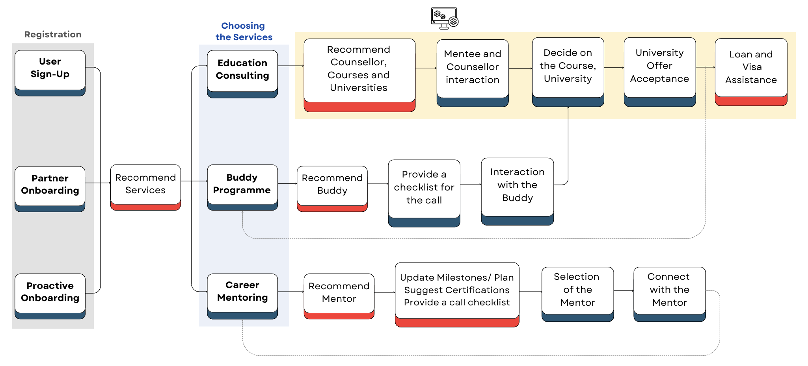
BUSINESS FLOW CHART
Student Management System
AI/ ML driven
User
Registrations
Services
Offered
Product
Offered
Buddy - Current University enrolled student

Slide 5






BUSINESS PHASES
Buddy Onboarding
Student Management System
Buddy Programme: B2C, Service
Pricing: Monthly subscription or Per-user based model
User: Mentee
SM Sytem: B2B, SaaS
Pricing: Usage based subscription model
User: Education Counsellor
Why: To build user-base
Mentor Onboarding
Future Partners
Career Mentorship: B2C, Service
Pricing: Monthly subscription or Per-user based model
User: Mentee (current or prospective students or alumni)
Universities
Recruiters
e-Learning platforms
Buddy - Current University enrolled student

Slide 6




CASH FLOW MODEL
INVESTMENTS
CAPEX
Platform Development
In-house Data Science team
Venture Capitalists
Angel Investors
I
N
F
L
O
W
O
U
T
F
L
O
W
SUBSCRIPTIONS
OPEX
B2B - SaaS
B2C - Buddy Programme, Career Mentorship
Cloud infrastructure maintenance
Marketing
Customer, Partner and Tech support
Buddy/ Mentor payments
MISCELLANEOUS
OTHERS
Advertisements
Sponsorships
University Partnerships
Bank Loans
Taxes
Interests and Repayments
Legal Expenses

Slide 7
STRENGTHS
WEAKNESSES
Personalised individual centric career mentorship
Mapping Mentees with the right Mentors (through AI)
AI/ ML based CRM systems
Initial investment to build and maintain CRM system
Mentor vetting process
Initial mentor availability
Education Consultants resistance to adapt to new CRM
SWOT ANALYSIS
OPPORTUNITIES
THREATS
Promote Universities
AI/ ML based talent assessments for potential employers
Advertisements
LinkedIn mentorship feature
Offline mentorship bypassing the platform
New competitors with deep pockets

Slide 8





PRICING MODEL
Product/ Services | SaaS Student Management System | Buddy | Education Counselling | Career Mentorship
Free Tier | Up to 20,000 student records | AI generated recommendations Meet 1 free buddy upon sign-up | All services available | -
Paid Tier | Pay-per-student Record | Monthly subscription - Meet 5 Buddies Pay-per-buddy | - | Pay-per-mentor Monthly subscription - Tailored list of Courses/ Certifications/ Milestones Mock interviews AI Progress Manager
TECHNOLOGIES
AI/ ML

Slide 9

THANK
YOU!

